Slide 1
UE20CS971– Project Phase – 1
End Semester Assessment
Student Name : Payel Dutta
Student SRN : PES2202100950
Project Title : Implementation of Image Generative models using iGPT
Project Guide : Kaustuv Kunal

Slide 2
Agenda
Problem Statement
Abstract and Scope
Literature Survey
Suggestions from Review – 3
Design Approach
Design Constraints, Assumptions & Dependencies
Design Details
Proposed Methodology / Approach
Architecture
Design Description
Results Obtained
Technologies Used
Project Progress
References

Slide 3
Problem Statement
Nowadays, due to the immense volume of images, it is difficult to effectively store all the data, and it is very likely that some images might get deleted or the quality might be compromised. ImageGPT, launched in the year 2020, was built on top of GPT-2 and has shown good performance in both image classification as well as image completion. In this paper, I wanted to explore the areas of image completion, where a model will be able to predict complete images when provided with half-context images, or low-quality images.

Slide 4
Abstract and Scope
Motivated by advancements in unsupervised representation learning for natural language, this paper sought to investigate whether iGPT model could also generate useful representations for images. Using a sequence Transformer, I trained the model to autonomously predict pixels, without any awareness of the 2D structure of the input. Despite being trained on low-resolution ImageNet without labels, the iGPT model achieved impressive results, displaying robust image representations, as evidenced by linear probing, fine-tuning, and classification with low-data.
This study will come in useful whenever there is a need for image completion. Given any random half image, the model will try to predict completed version of the image in multiple forms, which can be extended later to facial recognition, object identification as well as it might find its use in healthcare domain.

Slide 5
Literature Survey
The history of ImageGPT (iGPT) can be traced back to the development of the GPT (Generative Pre-trained Transformer) model by OpenAI.
The GPT model was designed to generate coherent and natural language text by training a large-scale neural network on a massive corpus of text data.
The success of GPT inspired the development of the iGPT model, which was trained to generate images from textual descriptions using a similar approach.
The iGPT model was introduced in 2021, and it builds on previous work on generative models for images such as the Generative Adversarial Network (GAN) and Variational Autoencoder (VAE).

Slide 6
Suggestions from Review - 3
Since this is a classification problem, it was suggested to use confusion matrix, to show the accuracy of the model.
This model is also capable to do image completion, hence guide suggested to check the loss of the model in comparison to existing models.
Both the above suggestions have been completed, and results are available in the upcoming slides.

Slide 7
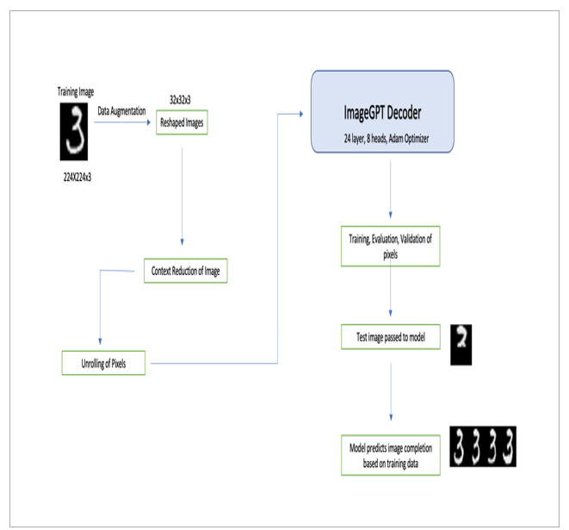
Design Approach

Slide 8
Design Constraints, Assumptions & Dependencies
The samples collected are from defacto MNIST dataset. Pytorch has processed this dataset in binary format, and this processed dataset has been used in this study.
The training requires a large and diverse set of data, and the processing of this large and diverse set needs reasonable processor speed and RAM. The cloud-based solutions such as Google Collab Pro cater to the needs of developing this model, while the traditional computing may not be very flexible.
In case, where the need is to predict newer image completion, the model needs to be trained with the corresponding dataset.
OpenAI’s GPT-3 API is costly. Since this study deals with image datasets, hence the parameters will be more, as a result free limit will quickly exhaust and it will be costly, hence GPT-3 has been avoided.

Slide 9
Design Details
Novelty - I used image augmentation to generate more samples and used MiniBatchKmeans for context reduction. I also implemented this model with Pytorch 1.13, the existing paper used Tensorflow 1.x
Performance - Model performance was measured using training and validation accuracy for classification task. iGPT-l model outperformed the existing models.
Reliability - It performed as expected with MNIST dataset. I passed half -context image to the model and it was able to generate full-context image.
Maintainability - This model is easy to maintain. After training I saved the model check point and config file.

Slide 10
Design Details (Continued)
Portability - This model is portable as it can run on Windows, Linux and MacOS.
Legacy to Modernization – Existing imageGPT model was built on tensorflow 1.x. Tensorflow 1.x was no longer supported. I implemented it using pytorch.
Reusability – This model can be re-used. The final model is saved in disk in .bin file format and can be loaded and used anytime.
Application Compatibility- This model is compatible with Python 3.8 , pytorch 1.13, Pytorch Lightning 2.0 and its higher versions.

Slide 11
Proposed Methodology / Approach
1. Data Collection: MNIST dataset is used to train the data.
2. Data Augmentation: “torchvision.transforms” library was used for augmentation for MNIST dataset.
3. Context Reduction for images: In this step I used MiniBatchKMeans for context reduction.
4. Custom PyTorch implementation of the GPT2 language model : The actual GPT2 code was written using pytorch and the implementation of training and validation method was introduced.
5. Custom PyTorch implementation of the imageGPT model : In this step, the model was trained on the MNIST dataset with Adam Optimizer.

Slide 12
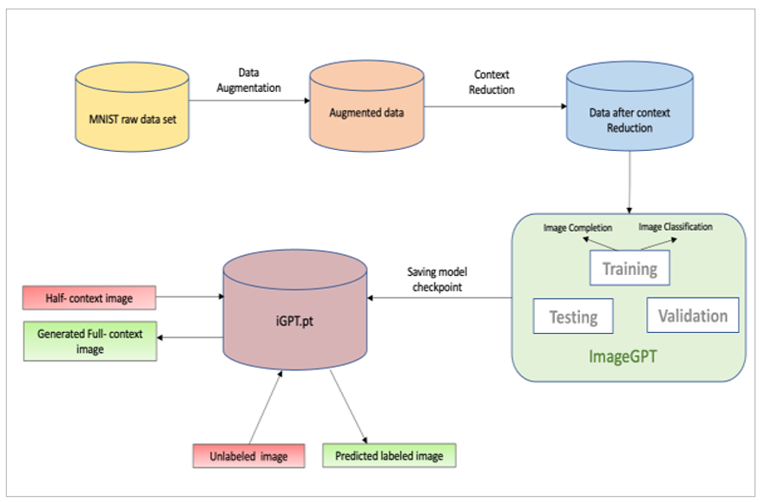
Architecture Diagram

Slide 13
Design Description (Algorithm)
Download MNIST dataset from OpenAI blob store.
Send the data for augmentation (Random Crop, Horizontal Flip,etc)
Resize the images to 28x28.
Calculate centroid using MiniBatchKMeans
Save the centroid in Numpy File.
Send the centroid and config file to ImageGPT (GPT-2) model.
Create train, validation, test data set using DataLoader.
Send train, validation, and test data set for training (Pytorch lightning library is used to speed up training process).
Once training completes, send random cropped image from MNIST dataset.
Model predicts full context images.

Slide 14
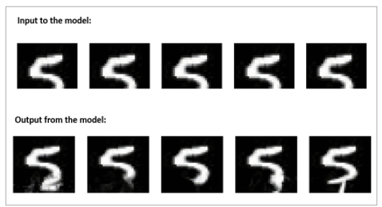
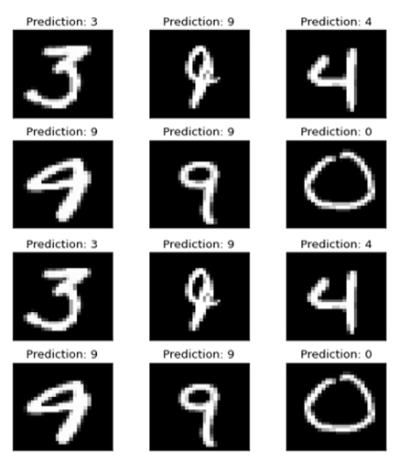
Results

Slide 15
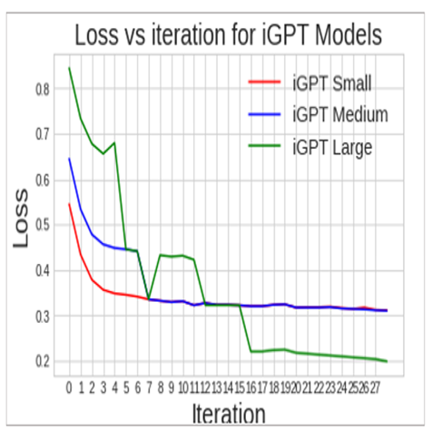
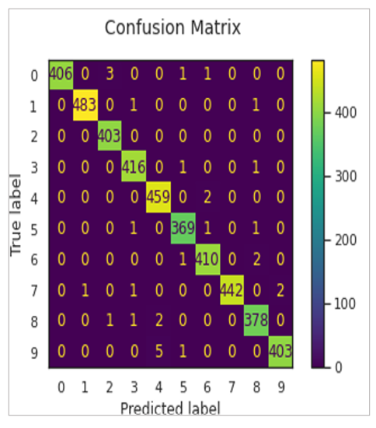
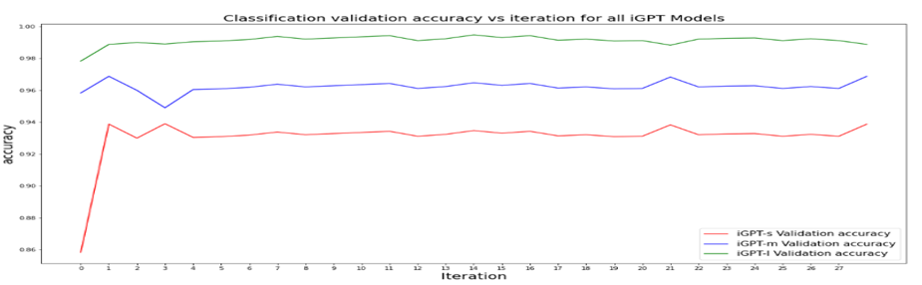
Results (Continued)

Slide 16
Technologies Used
Cloud environment | Google Colab Pro Plus
Development language | Python 3.8
Deep Learning Framework | Pytorch 1.13
Model Accelerator Framework | Pytorch Lightning
Third party Libraries | Pandas Numpy Sklearn Matplotlib Yaml
Log monitoring Framework | Tensor Board

Slide 17
Project Progress
The base paper has been successfully implemented as part of Phase 1 with MNIST dataset (grayscale).
For Phase 2, I plan on extending this model to colored dataset (CIFAR 10).

Slide 18
Chen, Mark and Radford, Alec and Child, Rewon and Wu, Jeffrey and Jun, Heewoo and Luan, David and Sutskever, Ilya. Generative pretraining from pixels. International conference on machine learning. Pages 1691-1703, PMLR, 2020.
Luo, Renqian, Sun, Liai , Xia, Yingce , Qin, Tao Zhang, Sheng , Poon, Hoifung, Liu and Tie-Yan. BioGPT: generative pre-trained transformer for biomedical text generation and mining. Briefings in Bioinformatics, Oxford Academic, 2022.
Su, Nigel, Yixuan and Collier. Contrastive search is what you need for neural text generation. arXiv preprint arXiv:2210.14140, 2022.
Chang, Ernie and Shen, Xiaoyu and Zhu, Dawei and Demberg, Vera and Su, Hui. Neural data-to-text generation with lm-based text augmentation. arXiv preprint arXiv:2102.03556, 2021.
Ashish Vaswani, Noam Shazeer, Niki Parmar, Jakob Uszkoreit, Llion Jones, Aidan N Gomez, Lukasz Kaiser, and Illia Polosukhin. Attention is all you need. corr abs/1706.03762 (2017). 2017.
References

Slide 19


Thank You !!

